Slide 1

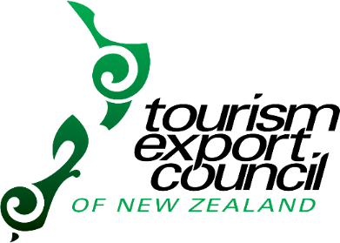
NEW ZEALAND TOURISM distribution channels
August 2016
Notes:
Most of you will know most of this information. We prepared this presentation because we noted 52% of members had downloaded the Planning for Success publication and a refresher might be helpful, particularly for new members and those that have a role with educating regional industries.

Slide 2

WHAT IS AN
ITO/IBO/DMC?
A common perception…
AKA:
Inbound tour operator
Inbound operator
Destination management company
“An Inbound operator is just a middle man who does nothing to add value to my business and takes a huge cut for doing nothing”
Notes:
Old view of what an ITO does and common perception. ITOs have had to adapt to a changing environment to remain relevant and of benefit to

Slide 3

So what do
ITOs actually do?
For Overseas Clients:
Research and recommend product to suit client specific requirements
A one-stop-shop to book all their New Zealand product including 24/7 support & one payment
Protect space for brochure programs e.g. allotments
Proactively seek new wholesalers to work with who are often not yet selling NZ
ITOs often enter emerging markets before TNZ has the funding to do so:
- teach trade how to sell New Zealand
- train trade in NZ101
- introduce your products to new clients
Prepare and distribute an annual tariff and or online tariff (all info in one place)
Provide product updates through newsletters, mailings, online
Organise client famils in conjunction with our supplier partners – exposure
Operate offices overseas to support our clients in converting sales, training their staff
Participate in marketing partnerships with these offshore clients to promote New Zealand
Notes:
Lesley, check point 3 prepare and distribute an annual tariff? What does this exactly mean?

Slide 4

So what do
ITOs actually do?
For NZ supplier partners
Help spread news of your product with our clients and grow your sales
Invest in your product and ours by visiting our clients in-market sometimes 2-3 times per year to grow the relationships, encourage more NZ brochure space
Welcome supplier partner visits to update our staff on your product and changes
We can easily invest several hundred hours of time and effort before any bookings are made that you don’t see
Provide business year round through the variety of markets we cover
Provide regular business of many types: FIT, group, series, incentive, special interest
…and ITOs invest thousands of dollars in international travel costs to achieve all bringing business to NZ and your business
Provide payment protection – don’t have to chase your money down in the back alleys of Timbuktu (assume any credit risk)
Notes:
Payment protection – don’t have to chase your money down (unpaid bills) in the back alleys of Timbuktu. ITOs can help with payment collection or try other channels to assist your business with getting paid.

Slide 5

What ITOs ask for
in return?
Wholesale pricing
Access to inventory
Rates and terms and conditions needed 18 months in advance
Descriptive images and content
Same day turnaround for booking/quote requests
Be proactive in providing solutions to adapt products for different markets
Qualmark businesses preferred
COMMISSION $
Commission is only paid when the sale is made
Notes:
For an TEC ITOs to get Qualmarked we need to have 75% of product suppliers must be Qualmark endorsed e.g. accom, activity, transport supplier. The other 25% is for new entrants and those philosophically opposed to Qualmark. Qualmark is important to TEC full members. If you are not Qualmarked and wish to work more with trade (or start), you may consider getting Qualmarked.

Slide 6
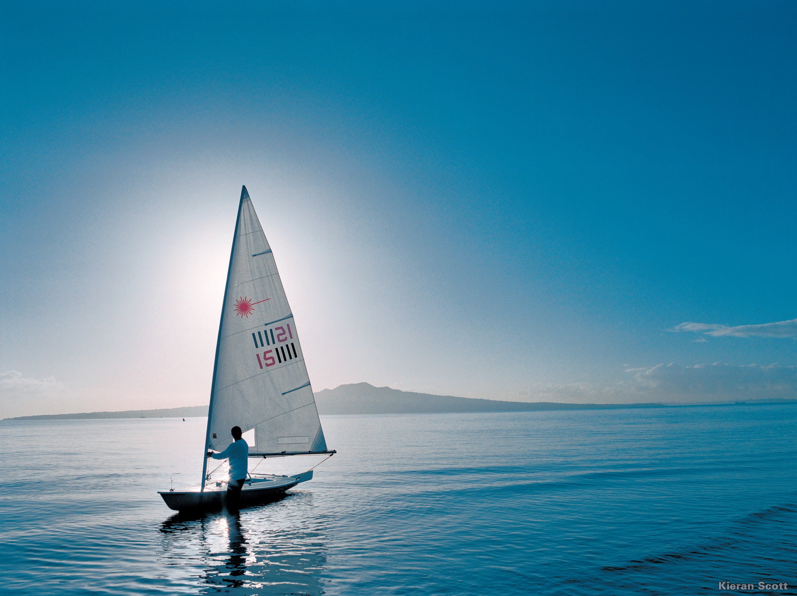
And what should
you expect from ITOs in return?
Clear concise requests
Abide by and honour your Ts and Cs
Assume responsibility for timely payment on behalf of overseas partners
Accurately position and promote your company/product
Promote your product to offshore networks
Treat you professionally and as a partner in the international distribution chain

Slide 7
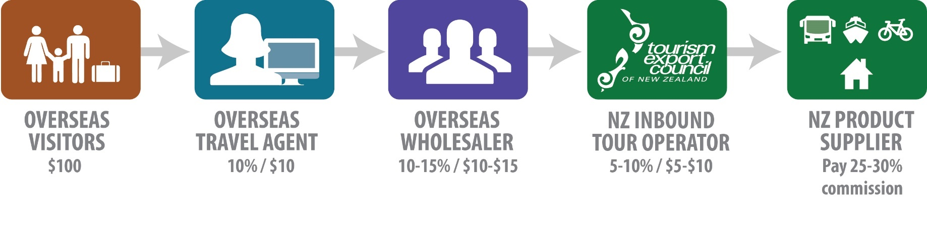
wholesale Distribution Channel
Pay 20-30% commission
Notes:
Everyone will know what the traditional or wholesale distribution channel has been like for many years. Most ITOs will pay 20-30% commission

Slide 8
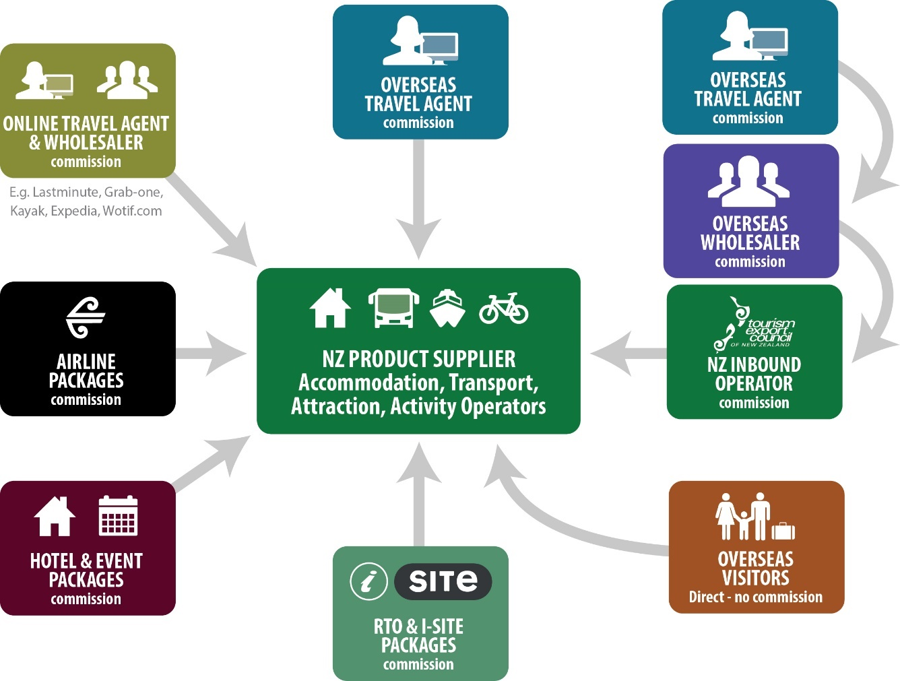
NEW Distribution MODEL
It is important you understand a commission is a fee you are paying someone else to promote your business. It should be viewed as an investment to generate sales, not as a cost to your business. If you do not wish to pay commission and you want to work with international visitors, the alternative is for you to go direct to each market to generate sales.

Slide 9
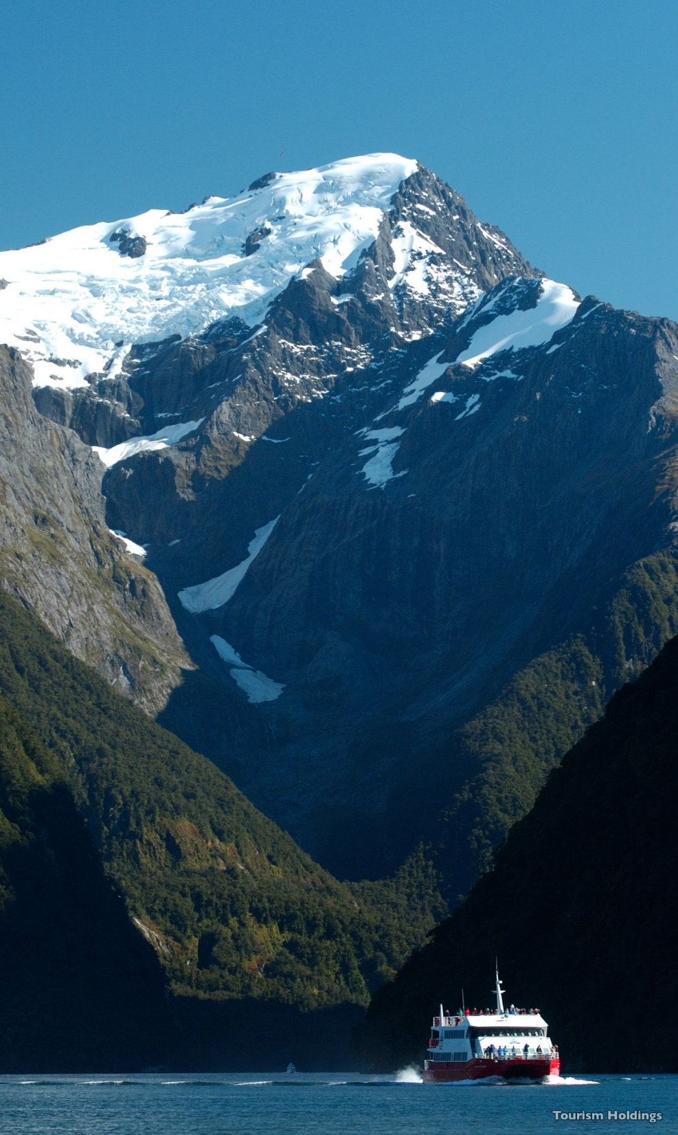
PREPARING TO WORK
with an ITO?
Do your homework:
Visit the TEC website to check which markets ITOs work in and type of client e.g. group, FIT
Visit the ITO website/brochures - check their itineraries ahead of time to determine:
Who are the ITOs customers? Check age and any cultural considerations
How long is the itinerary in your area and what do they do?
How many passengers per group or are they FIT/SIT customers?
Consult RTO regarding ITOs who work in your region
Helpful to visit ITO office or offer ITO staff to famil
Know their business before you tell them about your business!
Notes:
Some NZ inbounds will have itineraries on websites, some are trade only websites. Which means wholesalers offshore can access rates direct with ITO i.e. Not necessarily consumer websites . When communicating with ITO let them know you are a TEC member and that will help getting past the gatekeeper, helpful for new members.

Slide 10
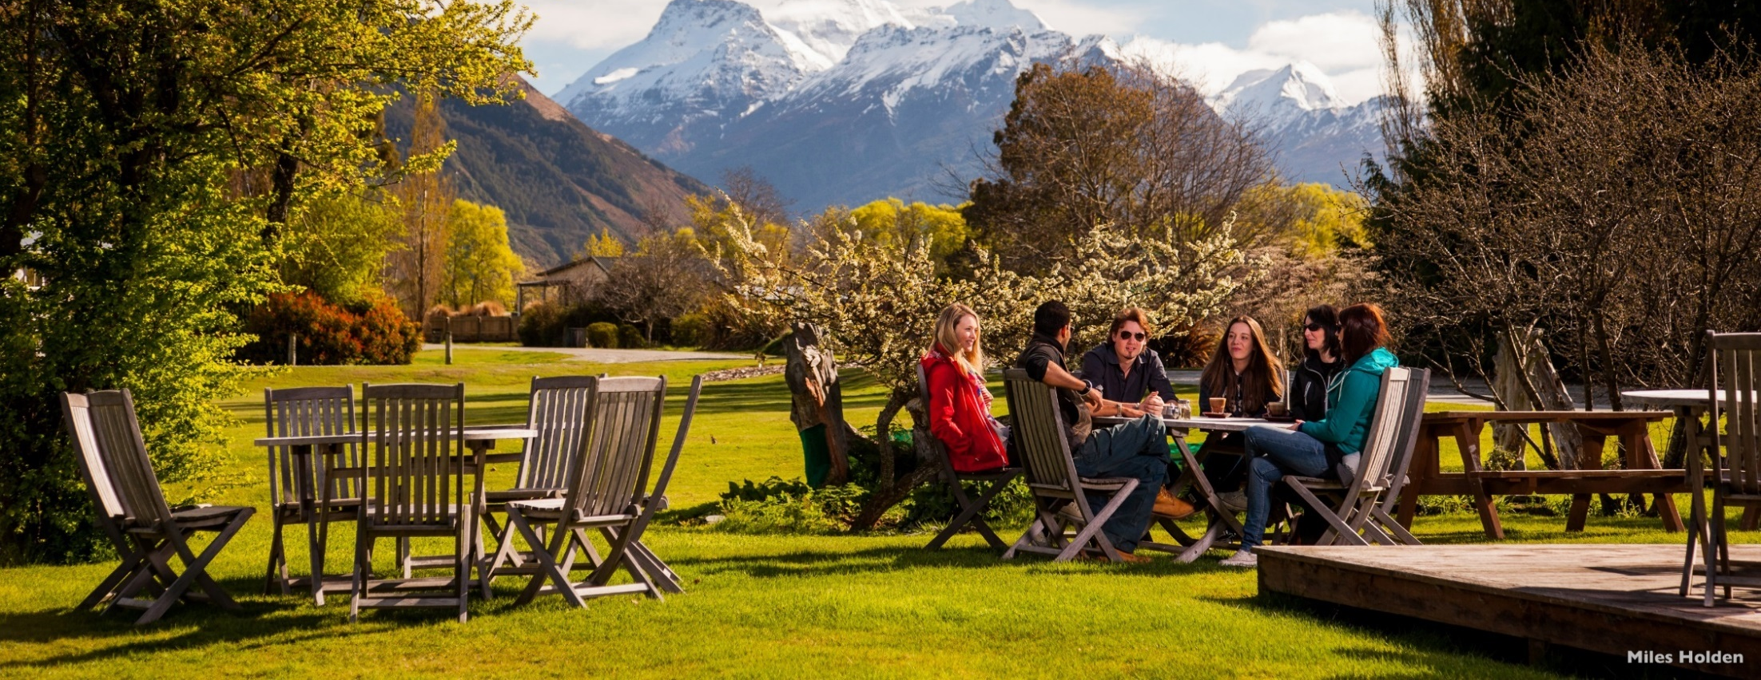
ITOs are different
Different travel type:
Global representation
Single market e.g. China
Group coach tours only
- Series tours
- Ad hoc tours
- special interest & incentive
Seat and coach tours (scheduled service)
FIT and SIT
Self-drive only
Notes:
Some ITOs will focus mainly on group or series business, others will be FIT and some a combination.

Slide 11

ITOs are different
Different travel client:
General sightseeing
Premium or luxury
Cruise
Business Events and Incentives
Special interest or bespoke e.g. golf, food
Education
Family groups
ITOs will use different promotion activities
for different segments of the mark
Notes:
Reasons (motivation) for why people travel differ from client to client based on culture and interest

Slide 12

ITOs have adapted:
Change from % group to % FIT (self drive)
Upgraded technology and direct connect links with suppliers eg. Site-minder, Tour Connect
Online booking engines and online tariffs
Having to work harder to realise value
More detailed in presentation and itineraries
Diversified product range and itineraries
Retail/promote other ITO product
New niche ITO start ups Education, Golf, Luxury sector

Slide 13

ITO intelligence
Key Inbound findings:
40-55% of all international leisure business comes via inbound tour operators
ITOs contribute $496 million to industry
51% group bookings, 31% FIT – others up to 6 % were education, MICE and Cruise
40% of group bookings were ‘series tours’ with 60% ‘ad hoc groups’
An average of 30% of FIT bookings were self-drive, 43% seat in coach and 27% private touring
Lead time varies between markets but Indian and Chinese markets have the shortest lead time with around 40% of bookings occurring in the month prior to travel
ATEED-ITO Report June 2015 (Angus Associates)

Slide 14
INBOUND TOUR OPERATOR business type %
51%
31%
TEC Member survey August 2016
Notes:
%percentages do not relate to previous slide. % are estimates of breakdown of ITO business (full members) and segments. It is interesting to note ITOs are active in the domestic market and grown business in education, C & I and business events. No longer just leisure visitors.

Slide 15
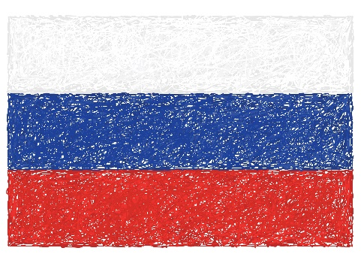
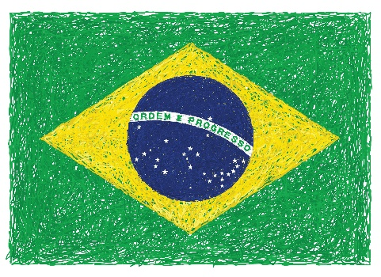
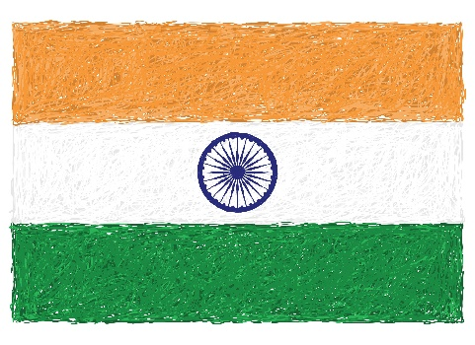
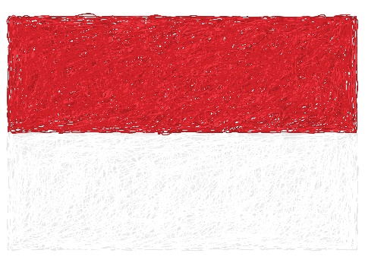
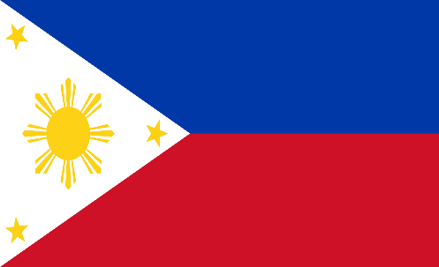
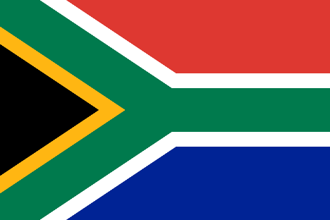
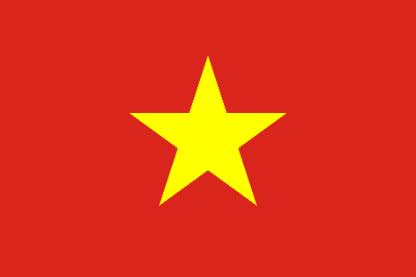



ITOs AND EMERGING MARKETS
RUSSIA
BRAZIL
INDIA
INDONESIA
VIETNAM
MIDDLE EAST
PHILLIPINES
SOUTH AFRICA

Slide 16
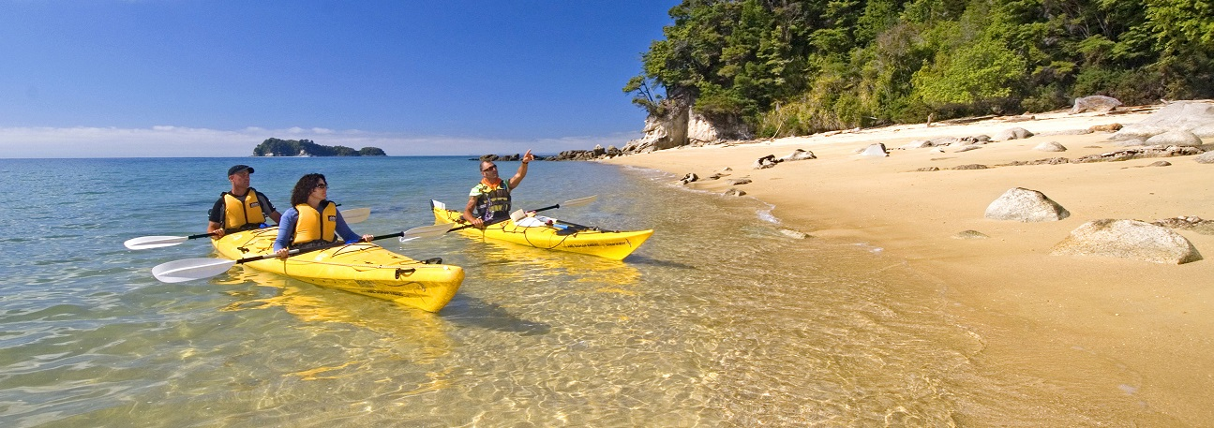
SUMMARY Benefits of working with an ITO
ITOs do your international marketing for you and act as a sales agent on your behalf
Access to new market intelligence, promote at tradeshows and coordinate famils
Provide long lead time wholesale bookings which assists with business planning efficiency
Volume bookings and repeat business year round
Offer security of working with a New Zealand partner
Notes:
ITOs value the partnership we allied members. Benefits of working with an ITO include ….as per list
Long lead wholesale bookings – help you plan in advance
Business planning for efficiency or productivity. Knowing you have forward bookings can help you to roster staff, purchase food and beverage, plan transport options to/from activities etc.

Slide 17
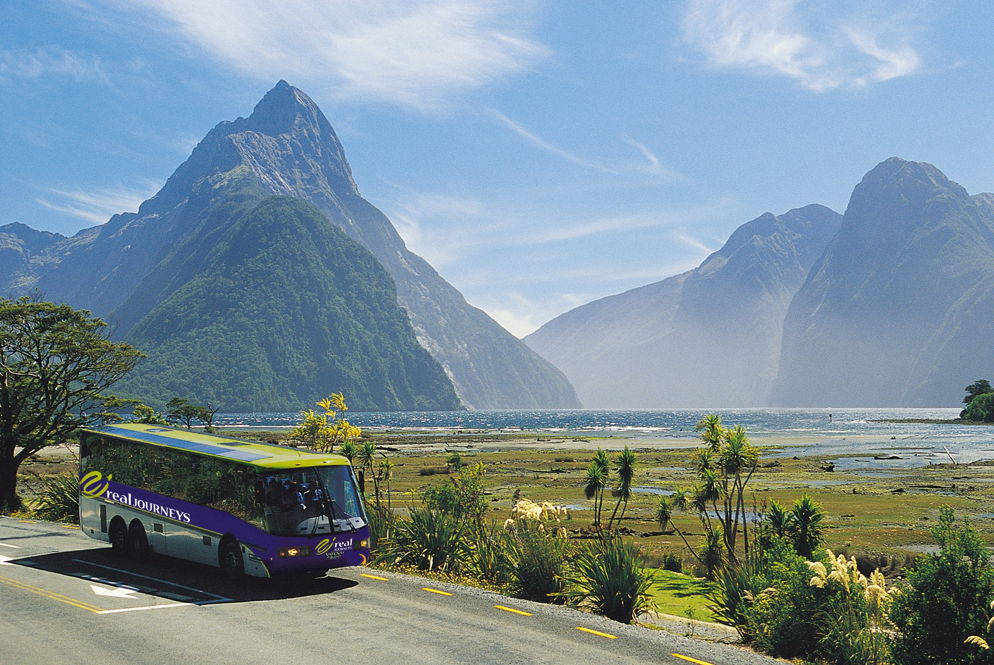
So WHAT IS our value?
Reality of what an ITO does…
“Promote and sells your product outside New Zealand
AND
purchases your product in New Zealand”
Notes:
Promote and sells your product outside New Zealand and purchases your product in New Zealand

Slide 18
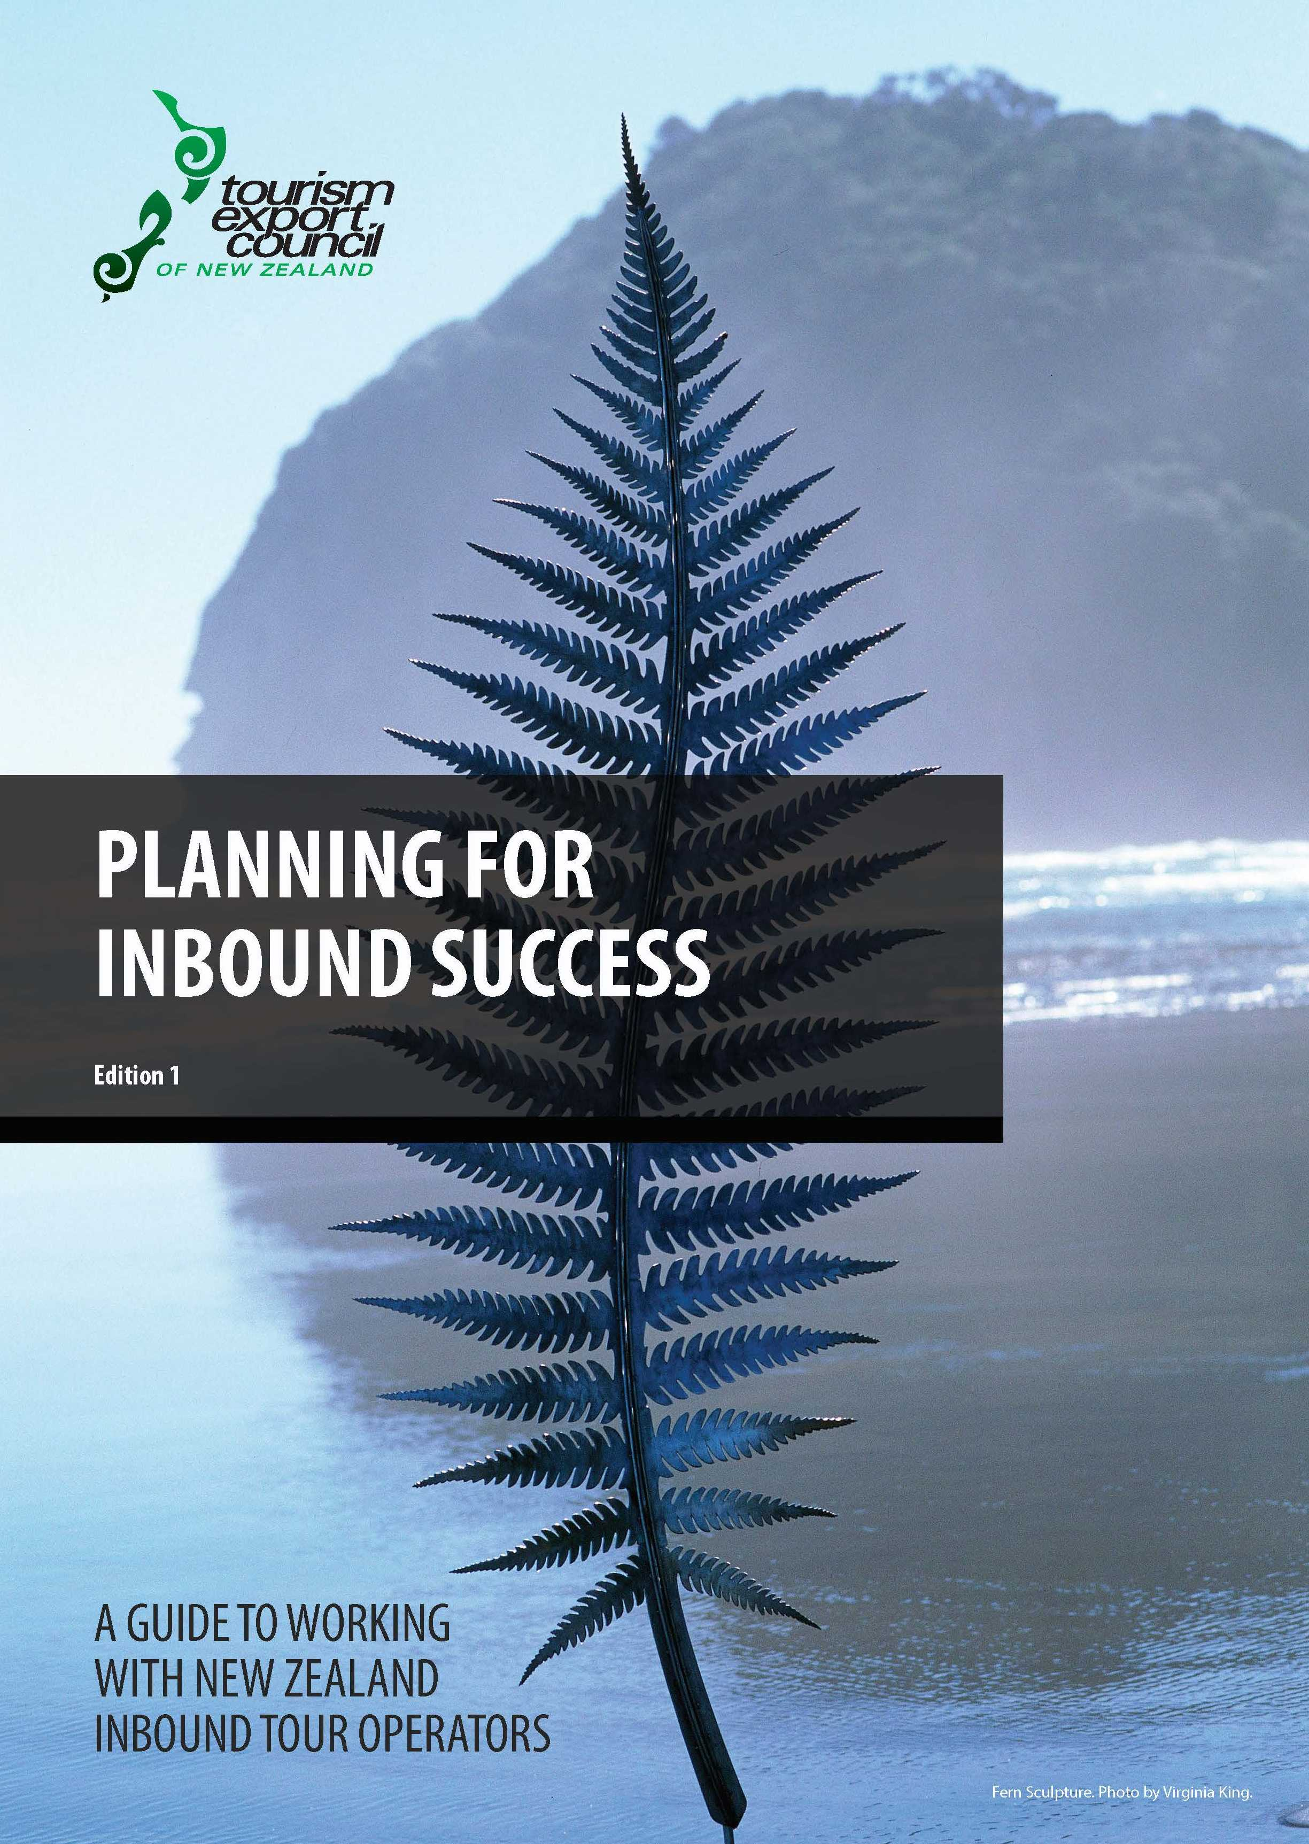
A GUIDE TO WORKING WITH
INBOUND TOUR OPERATORS
Since released 2014
800 print copies
3000+downloads
53% members
47% non-members
Notes:
Print copies (last ½ dozen)
3000 + downloads

